Slide 1
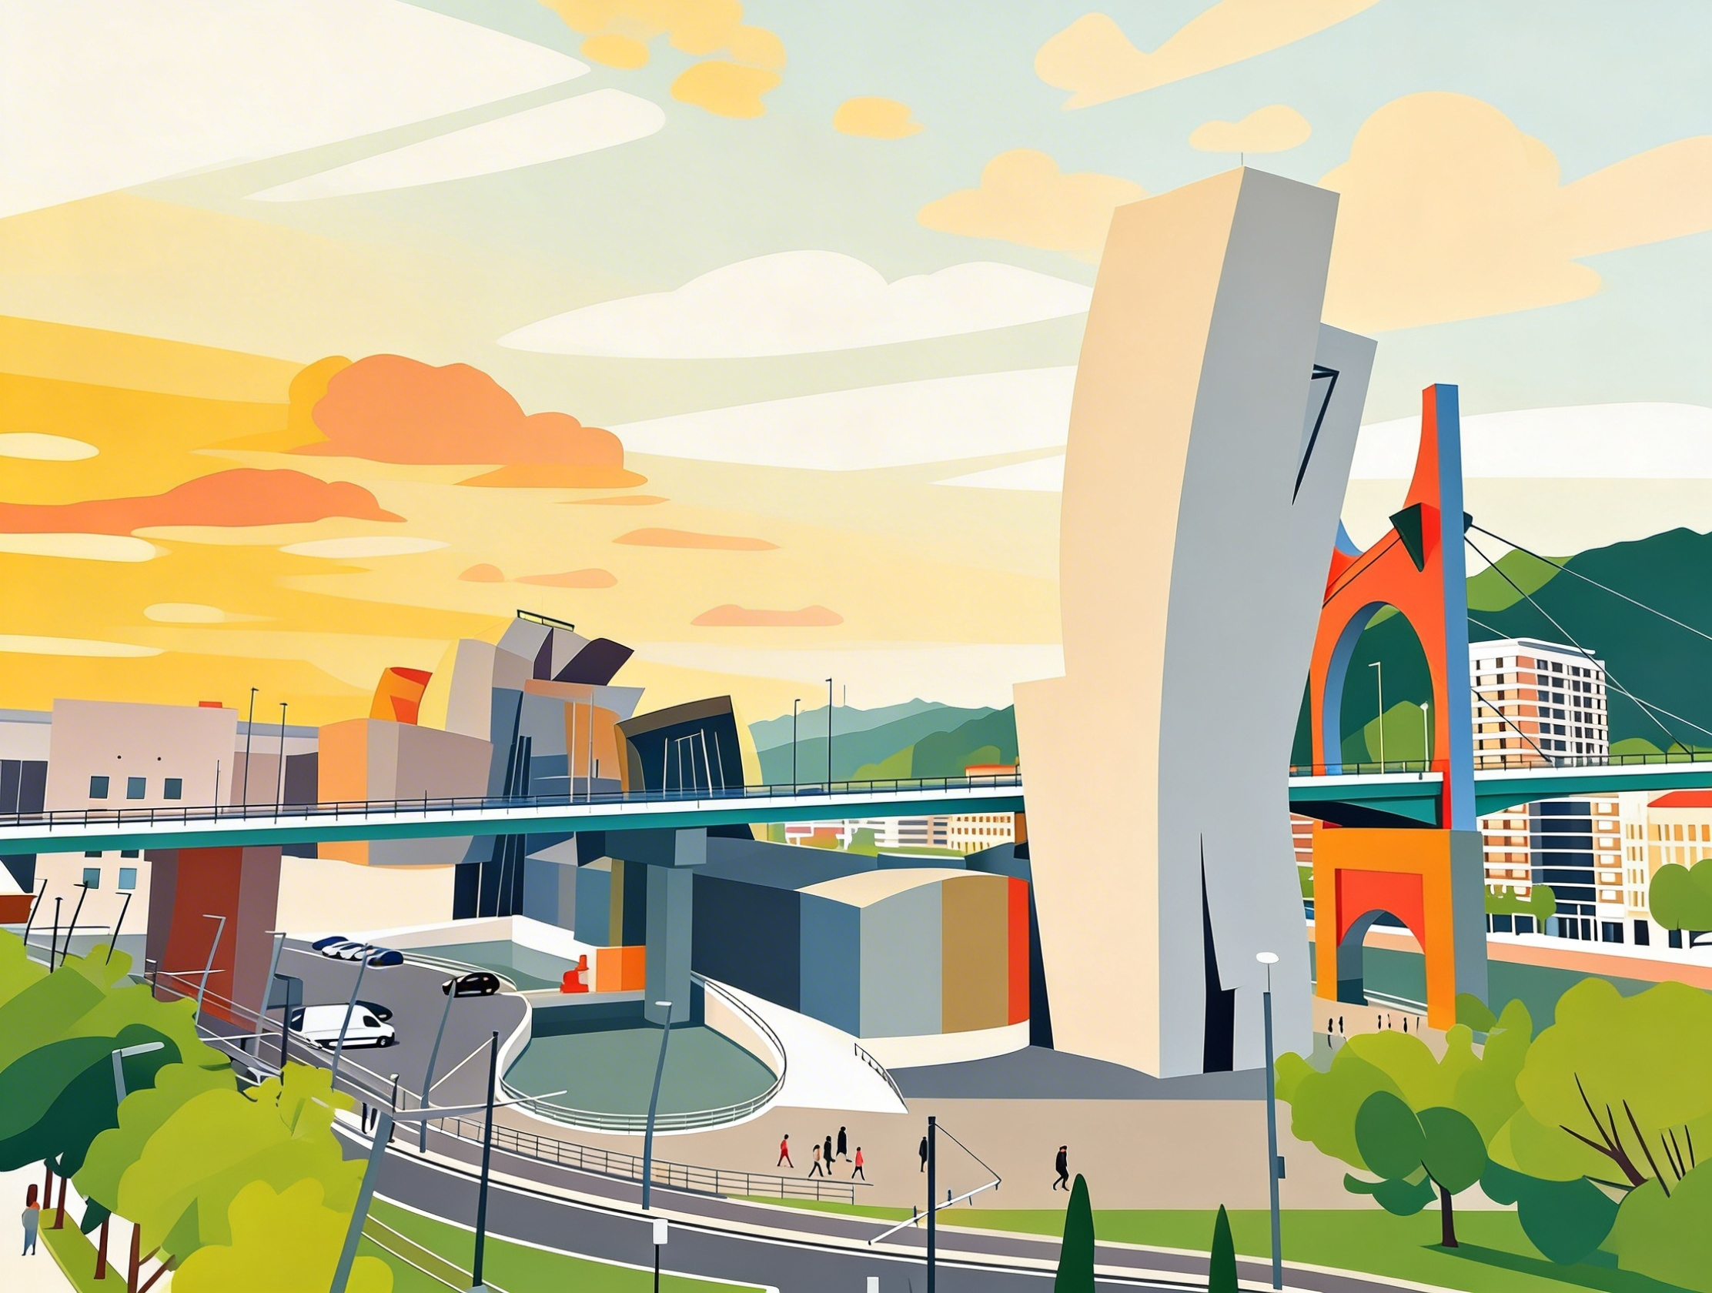
The Isle of Innovation: Blueprinting Bilbao's Future

Slide 2
have practiced the use of mixed conditionals to link past urban planning decisions to present strategic outcomes.
be able to use advanced business vocabulary related to sustainable investment and the knowledge economy.
be able to deliver a professional pitch for a city development project, using sophisticated hedging and persuasive techniques.

Slide 3



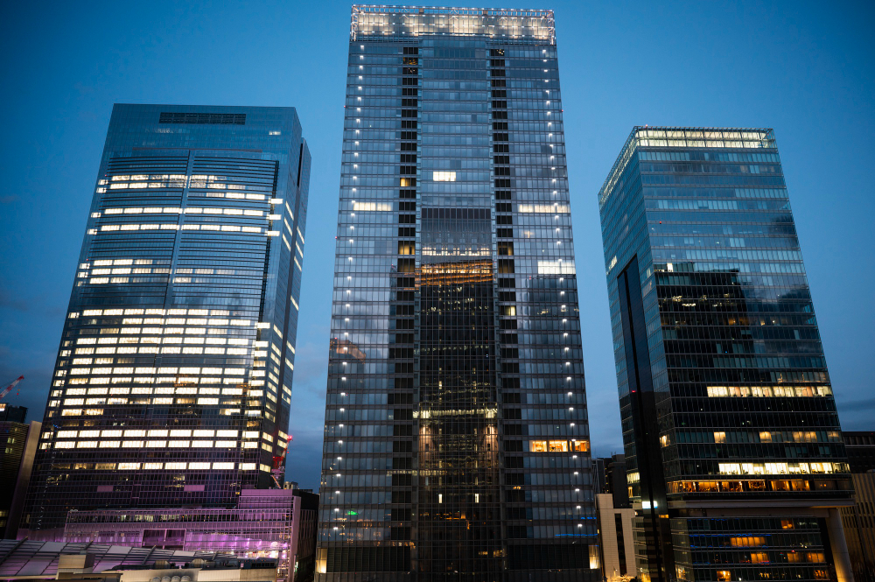
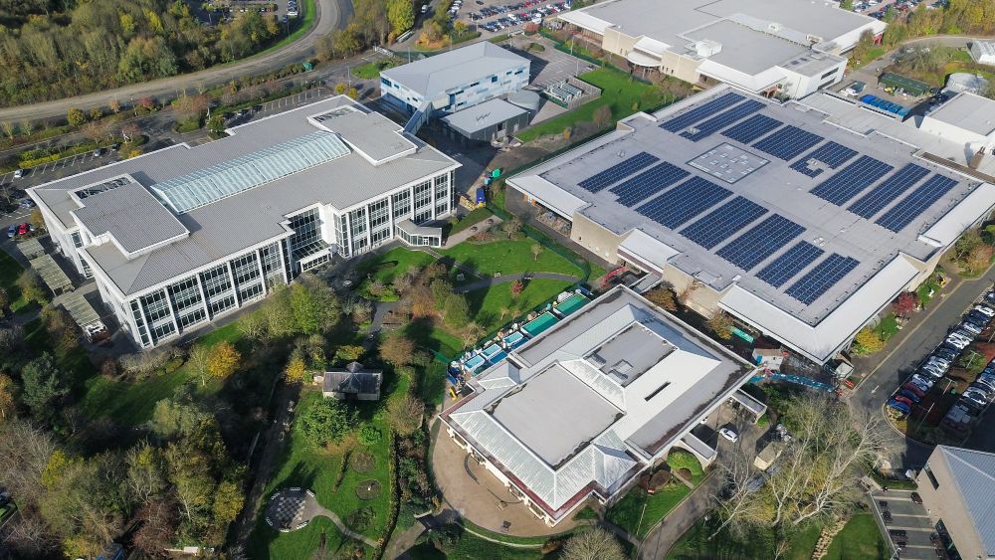
Strategic Urbanism
Task 1. You are a senior advisor for Bilbao Ekintza. Rank these factors from 1 to 5 based on how effectively they attract high-level foreign direct investment (FDI) to a city (1 = most effective, 5 = least effective).
Task 2. Consider these statements regarding urban development. Do you agree (A) or disagree (D)?
A clear commitment to carbon neutrality.
Proximity to elite technical universities.
High-speed digital infrastructure and 5G connectivity.
Generous tax incentives for green-tech startups.
Quality of life and cultural landmarks.
A
D
Environmental sustainability is a luxury that only wealthy cities can afford.
Economic growth and carbon reduction are mutually exclusive goals.
A city must have a flagship project to prove its innovation potential to the world.
A
D
A
D
Task 3. Look at the two images and answer the questions.
Which area feels more like a blueprint for 2026?
If you were the CEO of a sustainable energy company, what is the first question you would ask the Mayor of Bilbao before deciding to open an office on Zorrotzaurre island?

Slide 4

Useful Vocabulary
Task 5. Match the words on the left with their correct definitions on the right.
net zero
A. To lead a movement or a specific project.
renewable
B. A detailed plan or design for how something will work in the future.
to surround
C. Energy from a source that is not depleted when used.
flagship
D. The leading position in a development or trend.
a grid
E. To be all around someone or something.
a paradigm
F. A network of lines that cross each other to form a series of squares or rectangles; often used for electricity.
predictability
G. Achieving a balance between the carbon emitted into the atmosphere and the carbon removed.
to spearhead
H. The most important or high-profile project in a city’s portfolio.
blueprint
I. A typical example or pattern of something; a new model.
vanguard
J. The quality of being consistent or able to be expected, which is vital for investors.

Slide 5


Useful Vocabulary
Task 6. Complete the sentences with one of the words from the list. You might need to change the form of the word.
net zero / renewable / to surround / flagship / a grid / a paradigm / predictability / to spearhead / blueprint / vanguard
Zorrotzaurre is the ………………. project of our urban regeneration strategy.
The river that ………………. the peninsula will eventually provide hydrothermal energy for the local buildings.
Bilbao is ………………. the transition towards a knowledge-based economy.
We need to integrate various ………………. energy sources into the city’s smart ………………..
This new ………………. in urban planning offers the ………………. that international businesses require before relocating.
As a lighthouse city, Bilbao is in the ………………. of European sustainable development.
The project serves as a ………………. for achieving ………………. status in a dense urban environment.
Task 7. Complete the table by finding the related word forms or identifying the common business collocation from the video.
Verb | Noun | Collocation
to ………………. | innovation | an innovation ……………….
to ………………. | regeneration | ………………. regeneration
to ………………. | sustainability | sustainable ……………….
to ………………. | neutrality | ………………. neutrality
to ………………. | investment | ………………. direct investment (FDI)

Slide 6

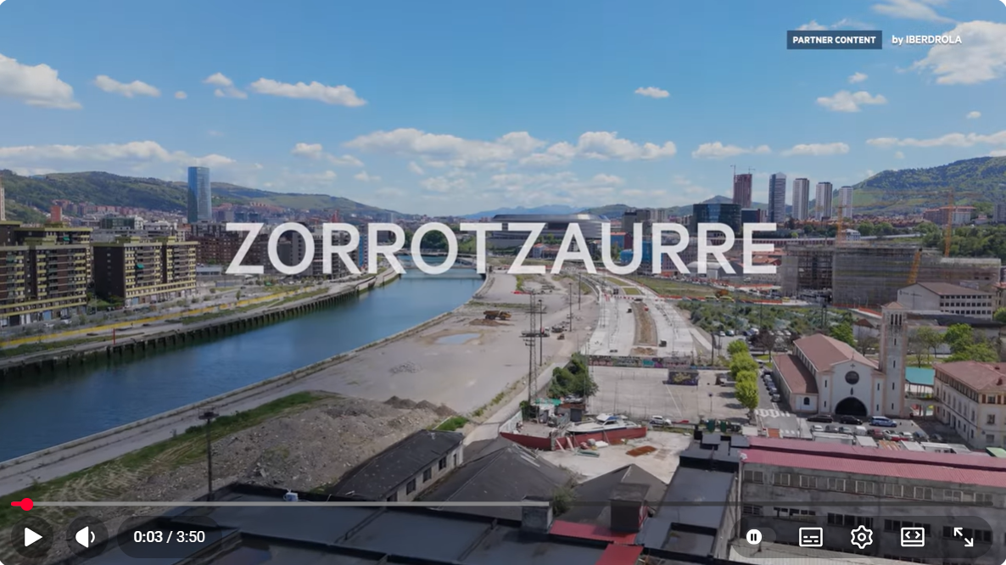

Zorrotzaurre: blueprint for a smart city
Task 8. Watch the video and select the statement that best reflects the main message.
A. Zorrotzaurre is primarily a residential development designed to solve the housing crisis in Bilbao.
B. The project is a real-world testing ground for integrating hydrothermal energy and carbon-neutral policies into an urban environment.
C. Bilbao is struggling to move away from its industrial past and is looking for EU funding to save the Zorrotzaurre peninsula.
Task 9. Complete the sentences with the correct information from the video.
Zorrotzaurre is described as a lighthouse city, which means it serves as a __________ for other European urban areas.
The heating system for the island will primarily use __________ energy from the nearby river.
The video mentions that the goal is to make the entire district __________ by 2050 at the latest.
One of the main challenges for the project is balancing the needs of different __________, including local residents and international investors.

Slide 7

Mixed Conditionals for Strategic Analysis
Task 10. Study the language explanation below.
We use mixed conditionals to link past events with present situations, or present states with past results. This is vital for analysing the long-term impact of city planning decisions.
Past Action -> Present Result (3rd + 2nd)
Formula: If + Past Perfect, would + bare infinitive.
Example: If the city council hadn't invested in the Guggenheim in the 90s, Bilbao wouldn't be a global brand today. (Reality: They did invest, and now it is a brand).
Present State -> Past Result (2nd + 3rd)
Formula: If + Past Simple, would + have + past participle.
Example: If Bilbao weren't so committed to innovation, it wouldn't have won the contract for the lighthouse city project. (Reality: The city is committed to innovation, which is why it won the contract).

Slide 8


Practice
Task 11. Use the prompts provided to create conditional sentences.
The city invested in green energy. Now, it is a leader in sustainability. (If...)
Bilbao is an attractive location for film scouts. This is why Netflix chose to film there last year. (If...)
We built the new bridge. Now, the island is easily accessible for commuters. (If...)
Zorrotzaurre has a high level of digital connectivity. That is why the tech giant moved its HQ there last month. (If...)
Write your answer here:
………………………………………………………………………………………………………………..
………………………………………………………………………………………………..………………
…………………………………………………….…………………………………………………………
…………………………………………………………………………..……………………………………
Task 12. Identify the mistakes in the sentences and rewrite them correctly.
If we didn't renovate the old warehouses, we wouldn't have this beautiful office space now.
If Bilbao wouldn't have a strong industrial history, it wouldn't be so good at engineering today.
If the government didn’t provide tax breaks, the tech hub wouldn’t have existes today.
Write your answer here:
………………………………………………………………………………………………………………..
………………………………………………………………………………………………..………………
…………………………………………………….…………………………………………………………

Slide 9

Task 1. Discuss the questions below.
Given the current economic climate, how can Bilbao Ekintza justify the high cost of net zero infrastructure to local taxpayers?
To what extent has the success of previous urban regeneration projects influenced the current strategy for Zorrotzaurre?
If you were a foreign investor, what specific synergies would you look for in the Bilbao ecosystem?
How does the concept of a lighthouse city help in branding Bilbao as a global vanguard of technology?
What are the potential risks of relying too heavily on a knowledge economy?
Useful Language
Speculating: It is highly probable that... / Assuming the targets are met... / We might conceivably see...
Hedging: Arguably, the main challenge is... / It appears that... / One could suggest that...
Analyzing Impact: This has led to a paradigm shift in... / The long-term implications are...
Task 2. You have two minutes to pitch Zorrotzaurre to a board of international investors.
Task: Focus on how the district combines hydrothermal energy, net zero transport, and a talented workforce.
Language: I would like to draw your attention to...
By leveraging our existing infrastructure...
If we look at the potential for synergy...

Slide 10
Task 3. Defend or challenge these statements below giving your reasons.
Branding a city as a smart city is just a marketing trick with very few tangible benefits for residents.
Zorrotzaurre will become an exclusive enclave for wealthy tech workers, leaving local people behind.
Task 4. Read the role cards below and play out the scenario. Use mixed conditional as much as possible.
Role A
You work for Bilbao Ekintza. You want to introduce a zero-emission zone on the island. Your objective is to persuade the business owner that the zero-emission zone is a non-negotiable part of the city’s blueprint for the future. You need to show empathy for their situation while maintaining the agency's position as a global vanguard of sustainability.
Role B
You are a Local Business Owner. You are worried that your delivery vans will be banned, hurting your profits. Your objective is to protect your profit margins and highlight the practical flaws in the flagship project. You are not against the environment, but you are against predictability being sacrificed for political optics.

